Slide 1
Topic Modeling on New York City
Group Project for Analytics of Unstructured Data
Prakhar Bansal
Karthick Ramasubramanian
Shubham Singh
Soumi Basu
Soumik Choudhuri

Slide 2
Problem Statement
Replaced with your own text
Replaced with your own text
Replaced with your own text
Replaced with your own text
Replaced with your own text

Slide 3
Why it matters
01 Write here a title
02 Write here a title
03 Write here a title
04 Write here a title
05 Write here a title

Slide 4
Data Sources
Replaced with your own text

Slide 5
Frequency of top words
Replaced with your own text

Slide 6
Lift Analysis
Replaced with your own text

Slide 7
MDS
Replaced with your own text

Slide 8
Topic Modeling

Slide 9

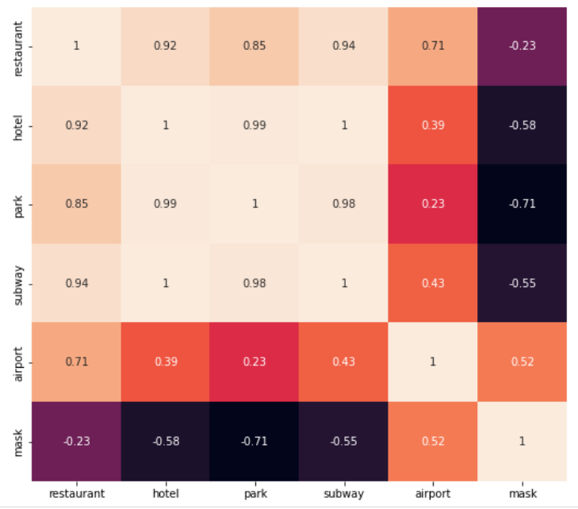
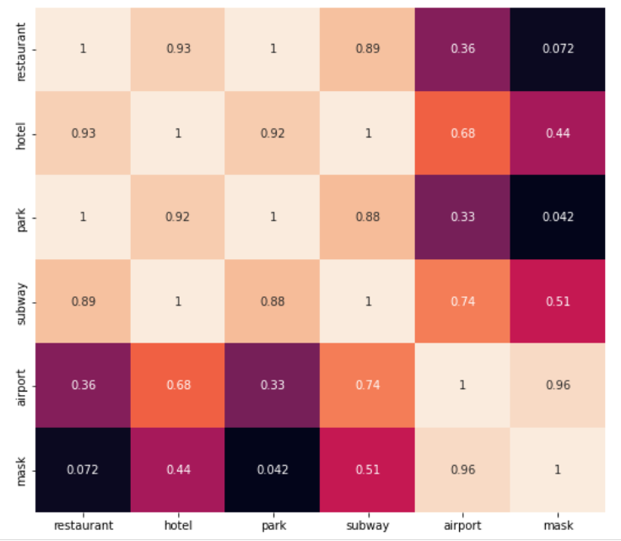
Embedder Matrix
Topic 1 : Quarantine
y=0: [“Quarantine”, “Travel”, “Vaccine”]
Topic 2: Restaurants
y=1: [“Restaurant”, “Bar”, “Food”]
X: Top 3 words from all 15 topics
Cosine Similarity of selected attributes generated from Embedder matrix trained on Topic 1 (Left) & Topic 2 (Right)
Notes:
!5 topics generated using LDA from all the 16000 comments of Tripadvisor.

Slide 10
Embedder Matrix
Cosine Similarity of selected attributes generated from Embedder matrix trained on above 2 topics
Notes:
!5 topics generated using LDA from all the 16000 comments of Tripadvisor.

Slide 11
Recommendations

Slide 12
THANK YOU

